Slide 1

Notes:
Walk-in Slide

Slide 2



Medical Reserve Corps Movement on Medication Safety, Opioid Rapid Response Team Collaborative Project
Missouri Region C North MRC &
Lincoln County Health Department

Slide 3
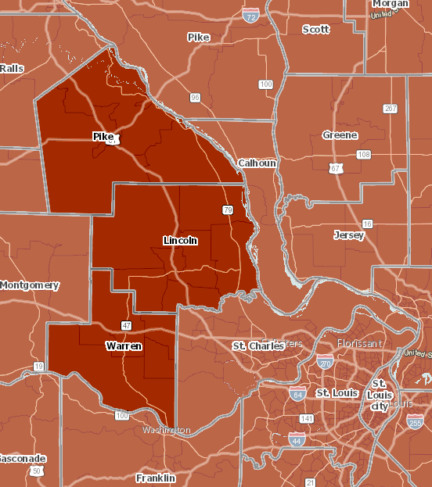
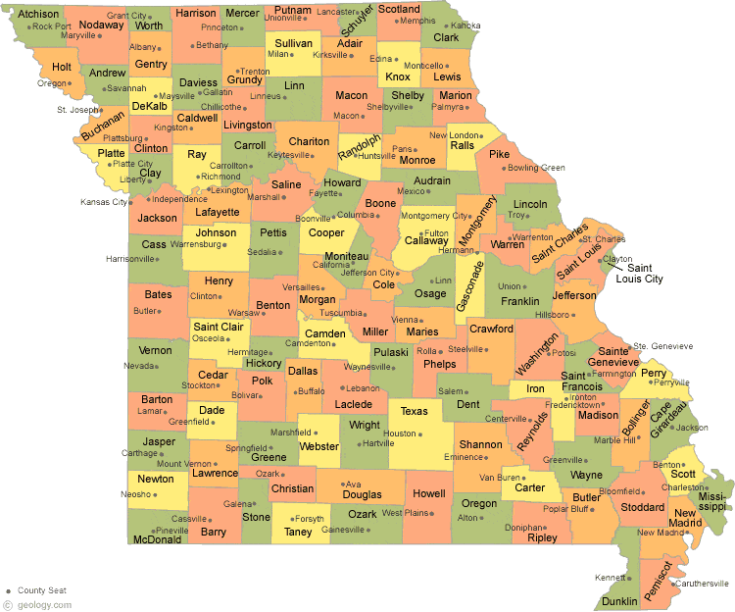

Missouri Region C North Medical Reserve Corps
3 counties
Pike, Lincoln, Warren
Large rural areas
Geographically distinct from urban St Louis region

Slide 4


Project Beginnings
Need was the impetus for improvement.
Additional MRC volunteers
Project(s) to increase engagement between emergencies

Slide 5
Project Beginnings
At the same time, data showed significant increase in county Neonatal Abstinence Syndrome (NAS) rates
500% increase in the incidence of babies born with NAS in the county from 2011-2016

Slide 6
Need for Improvement Need for a Movement

Slide 7

Notification of Funding
NACCHO MRC Challenge Award
Community Based Initiatives
Build MRC volunteer engagement & capabilities
Provide measurable outcomes
Engage community partners
Improve community health & resiliency

Slide 8
NACCHO MRC Challenge Award
Applied for MRC Challenge Award in December 2017
Project was accepted February 2018
Project design and data analysis February 2018-2019
First MRC training hosted February 2019
Launch of resource Toolkit March 2019

Slide 9
Why Medication Safety?
Identified a significant increase in babies born suffering from Neonatal Abstinence Syndrome (NAS)

Slide 10
Medication Safety
Medication safety is freedom from preventable harm with medication use
Using medication appropriately
Practitioners prescribing safely
Preventing medication errors
Understanding risks of taking medication during childbearing years

Slide 11
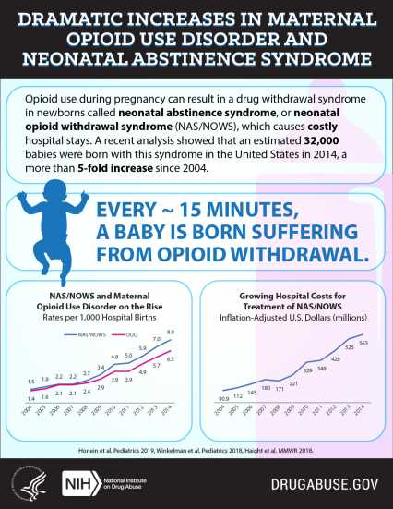
Overview of NAS
A group of conditions caused when a baby suffers withdrawal from certain drugs they are exposed to before birth.
Increased hospital stays, negative health outcomes, and higher treatment costs.
Citation: https://www.drugabuse.gov/related-topics/trends-statistics/infographics/dramatic-increases-in-maternal-opioid-use-neonatal-abstinence-syndrome​
​

Slide 12
What Drugs Cause NAS?
Opioids prescriptions such as
Codeine
Hydrocodone
Morphine
Oxycodone
Tramadol
Heroin and methadone
Amphetamines and barbiturates
Antidepressants
Benzodiazepines (sleeping pills)

Slide 13
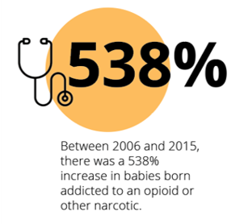
Missouri Increase in NAS
Citation: Missouri Department of Health & Senior Services 2019​
​
Citation: Hospital Industry Data Institute. *NAS births in 2016 identified with ICD-10 CM codes P961 and P962. NAS births in 2006-2015 identified with ICD-9 CM code 7795.

Slide 14
Lincoln County Increase in NAS
Citation: Missouri Department of Health & Senior Services 2019

Slide 15
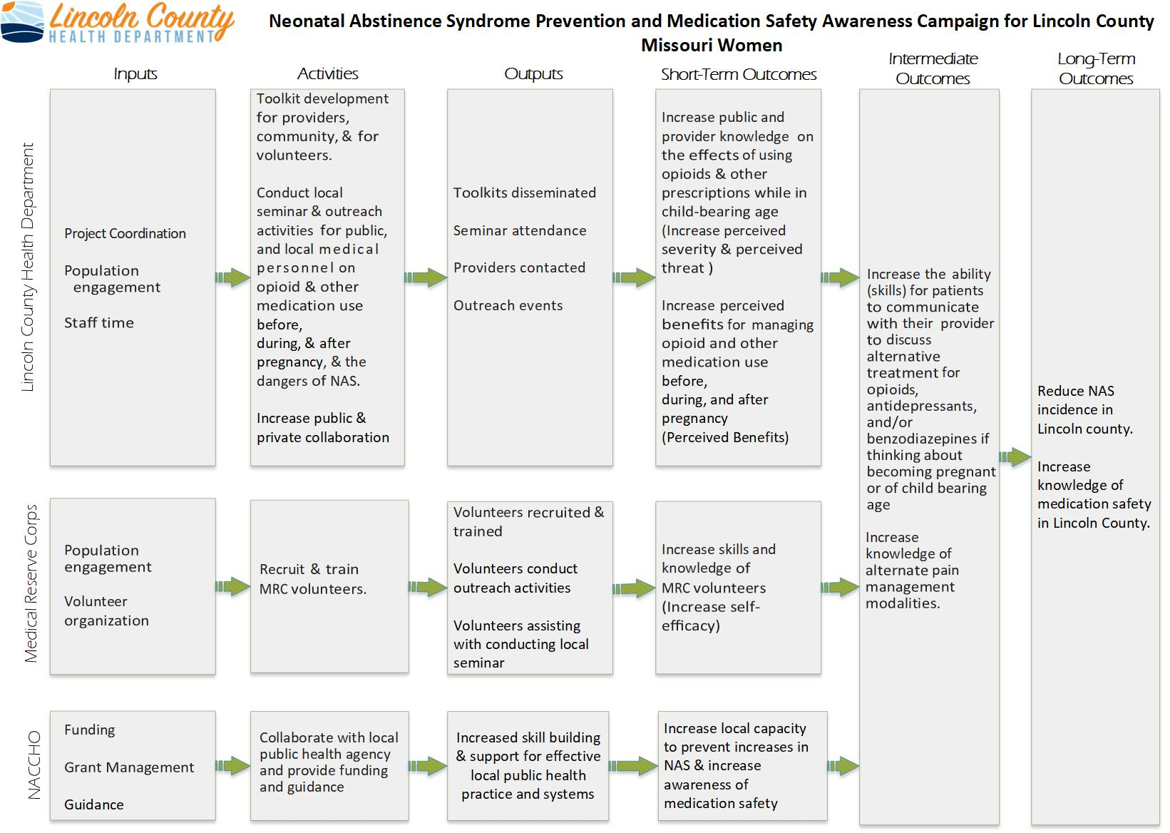

Slide 16

MOMS Toolkit

Slide 17

Project Design
Movement on Medication Safety
Materials are bright & appealing​
90's themed​

Slide 18

Project Design
Easy to use for clinical and community members
One-stop resource guide
Split into 3 sections

Slide 19
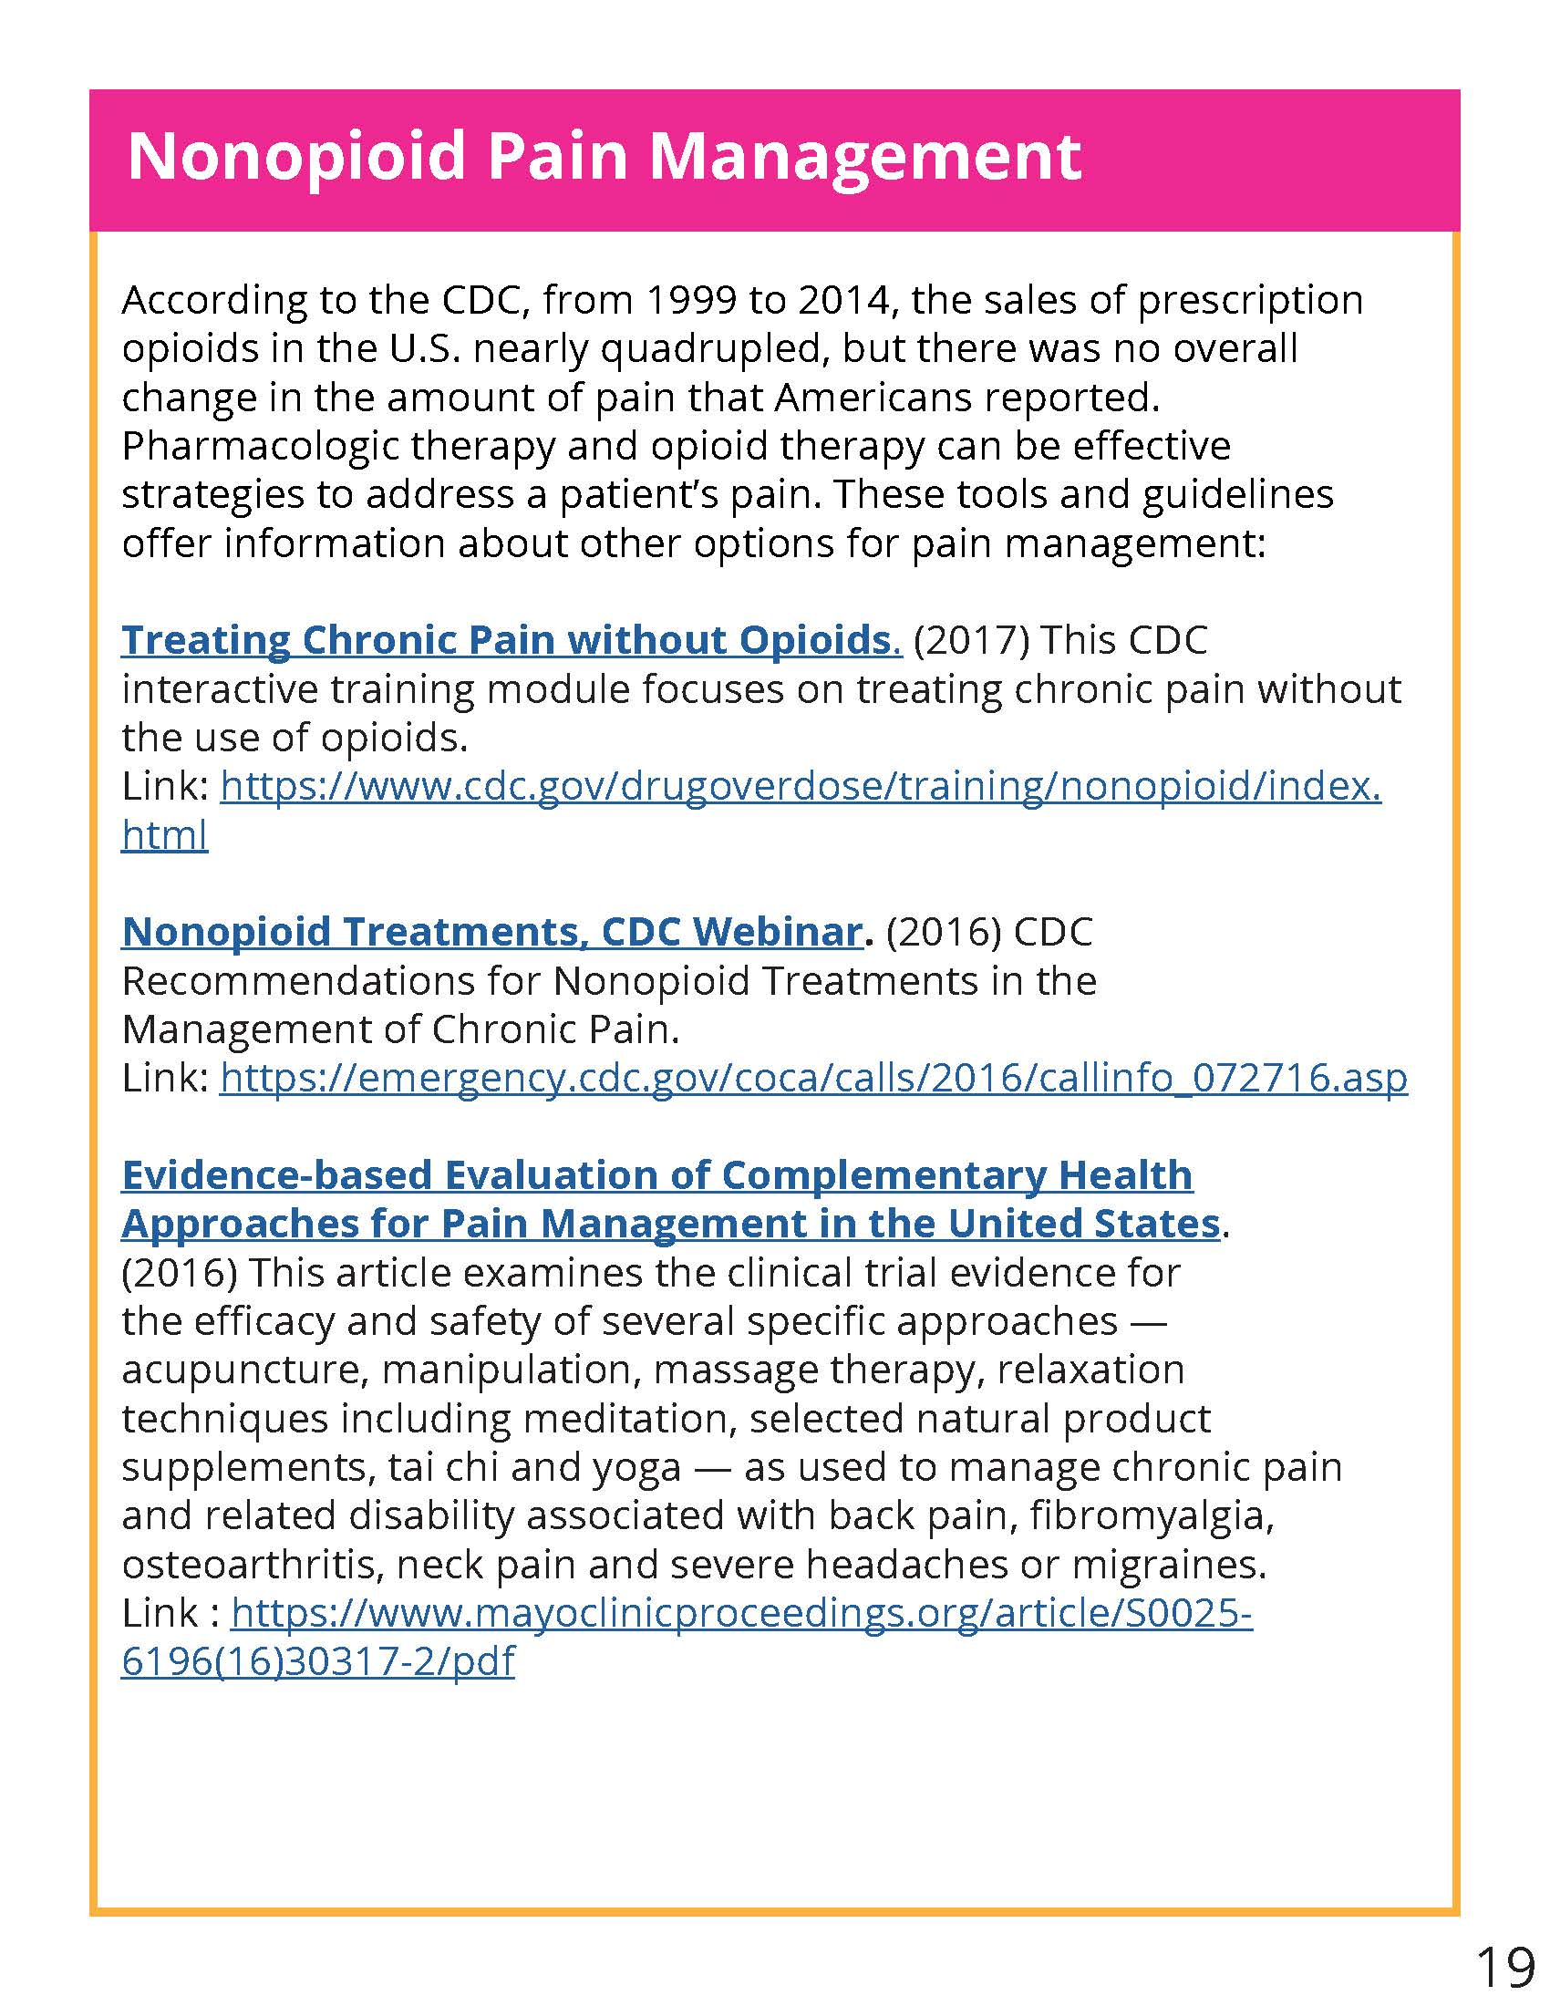
Project Design
Digital as well as print format
Resource locations included
Clickable links

Slide 20

Volunteer Recruitment
Social Media
Other volunteer response agencies
Faith based organizations
Social clubs
Local employers
Print Media
Open Houses
Trainings

Slide 21
Volunteer Training
Created Volunteer Activity Calendar
Scheduled several 1-hour trainings
Hosted a train-the-trainer for Pike & Lincoln County Health Department Staff

Slide 22
Training Goals- Health Literacy
Health literacy and cultural competency are critical

Slide 23
Rapid Community Outreach Team Objectives
Increase the health of children born to Lincoln County mothers​
Increase community resiliency​
Increase community awareness of opioid epidemic​ & its effect on families
Create a specialized volunteer rapid response team to address opioid specific needs in the community ​

Slide 24
Opioid Rapid Response Team Activities
For sudden rises in opioid associated deaths (surge and mass casualty)
For increased NAS numbers reported by local hospitals
To provide community outreach and training on NAS
To facilitate provider outreach and training on NAS
Post overdose visits to victims, friends, or family members

Slide 25
Project Challenges
Volunteer recruitment
Commuter population
County demographics
Attitude towards volunteering/perceived risk
Volunteer management
Availability/engagement of providers

Slide 26
Challenges - Volunteer Recruitment
Common pool of people - "tapped out"
Geographic challenges
Social media driven
Notes:
By the nature of the rural areas that we live in other volunteer organizations including other response agencies, faith based volunteer groups and employer related volunteer organizations all compete with the same pool of participants.
People being asked to do "all the things" in a rural area...we many of the same faces at meetings. Everyone knows one another, so there is not as much incentive to get out a "meet new people."
Family challenges – kids, caring for older parents
Geographic challenges
Largely a commuter population. 54% of our workforce travels 30 minutes or more to work each day.
Around three quarters of our county population live in a rural area, so it's not a quick drive to go to a meeting.
Lincoln County is a bedroom community to St. Louis and a large number of residents commute for extended periods. This reduces the available or perceived "free time" that individuals may have to devote to extracurricular volunteer activities. We accommodated for commute times and schedules by making sure that the trainings were scheduled on different days, I.e. not always on a Tuesdays, and that they were at times that would account for commuting and dinner. We also created an online volunteer activity calendar on our website and scheduled the MOMS Training multiple times.
Social media driven
County newspaper is free, but readership on the decline. Largely retirees/elderly
We know that more people are looking at social media – figuring out how to make it work for us (algorithms, what to post, boosting pages likes, etc.)
People are very engaged when they have that phone in their hand...maybe not so much when it's time to come out to a meeting, and not urgent. Or raining, or it's the one thing they have to drop for the week.

Slide 27

Challenges - Volunteer Recruitment
Attitude -
"The government will handle it."

Slide 28
Challenges - Management
Keeping volunteers engaged long-term
Size of health department
Internal staffing priorities

Slide 29
Challenges - Other
Availability/engagement of providers

Slide 30

Project Successes
Positive feedback from volunteers
Increase in number of volunteers
Increased collaboration across programs
Provider engagement

Slide 31

Future goals
Use in larger county opioid efforts
Continued volunteer recruitment & training
Encourage provider engagement

Slide 32

Every problem has in it the seeds of its own solution. If you don't have any problems, you don't get any seeds.
-Norman Vincent Peale

Slide 33
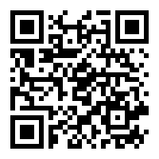
Find the Toolkit at
https://lchdmo.org/movement-on-medication-safety-moms

Slide 34
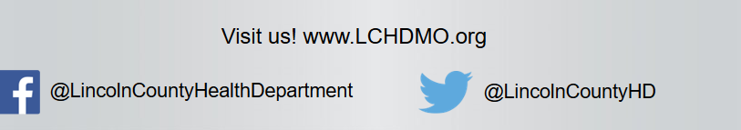
Contacts
Genevieve Weseman, MPH
Emergency Planner & Surveillance Specialist
Phone: (636)-528-6117 Ext. 408
Genevieve.Weseman@lchdmo.org
Jackie Decoster, MPH Candidate
Public Health Intern
Phone: (817)-675-8889
Decosj@lchdmo.org
Jennifer Harris, MPH​ ​
Director of Programs ​
Phone: (636)-528-6117 Ext. 403
Jennifer.Harris@lchdmo.org​
​Sarah Valenza, CHES ​
Public Health Educator/Outreach Coordinator
Phone: (636)-528-6117 Ext. 402
Sarah.Valenza@lchdmo.org​

